Slide 1


Day 5 Lecture 2: Analytical methods to track epidemics
Short course on modelling infectious disease dynamics in R
Ankara, Türkiye, June 2023
Dr Juan F Vesga

Slide 2
Aims of the session
Understand the importance and caveats when assessing Epidemic curves
Consolidate the knowledge around reproduction number
Understand the use of reproduction number in practice
Review methods used to track epidemics in real time

Slide 3
The epidemic curve

Slide 4
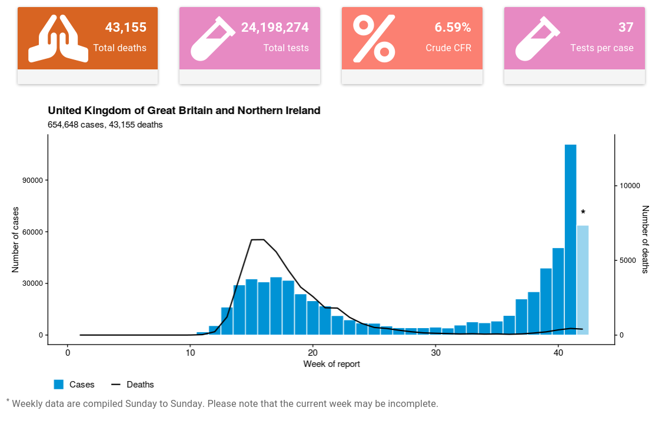
Looking at case incidence: epidemic curves
Incidence
Number of new cases per unit of time (e.g. daily, weekly, etc.)
May or may not be divided by population size
Epidemic curve (epicurve)
Plot of incidence over time
Ubiquitous in analysis of epidemics
Used to assess epidemic progression
Source: WHO, COVID-19 UK.
4

Slide 5
Why we look at epidemic curves?
Visual assessment of epidemic state: growth, decline, or constant
Can be based on case reporting, symptom onset, or deaths
Underlying idea: assess transmissibility
Is the epidemic actually growing / declining?
How fast is it growing / declining?
How many cases should we expect in the next weeks?
Source: WHO, COVID-19 UK.

Slide 6
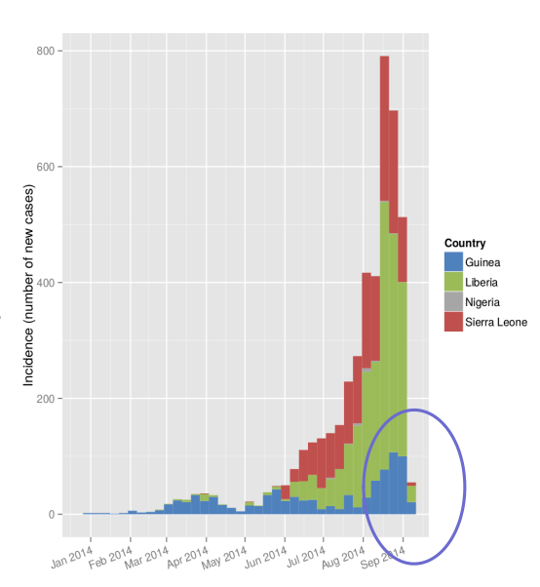
The impact of the data source used
Based on date of onset of symptoms
1 incubation period behind the outbreak
reporting delay = artificial decline
Based on date of notification
Longer delay than symptom onset
Impact of reporting process e.g. weekend effect
Based on hospital admissions / deaths
Longer delay than notification
Partial view of the entire population (only severe cases)
In all cases, strong possible impact of changes in reporting

Slide 7

Estimating transmissibility
Daily growth rate (r)
Slope of exponential growth / decline
r > 0 = exponential growth ; r < 0 = exponential decline
Approximately the daily relative change:
r = 0.1 ~ 10% daily increase
r = - 0.05 ~ 5% daily decrease
Doubling / halving time
Number of days for incidence to double / halve
Reproduction number (R)
Number of secondary cases by infected case
R > 1= exponential growth ; R < 1 = exponential decline

Slide 8
The reproduction number

Slide 9
The reproduction number R
average number of secondary cases generated by an index case
Incidence = 1
Generation 1
Incid = 2
Gen 2
Incid = 4
Gen 3
Incid = 8
Gen 4
Incid = 16
Gen 5
Epidemic possible only if R>1
Larger R → Larger expected epidemic size & require more intense control efforts

Slide 10
R can change over time
Because of “saturation” & changes in transmissibility
Incidence = 1
Generation 1
Incid = 2
Gen 2
Incid = 4
Gen 3
Incid = 8
Gen 4
Incid = 12
Gen 5
Important to monitor continuously
In a large population with no immunity → The basic reproduction number R₀
In practice → The case reproduction number R_{c}(t)
(average number of secondary cases generated by an index case infected at time t)

Slide 11
When transmissibility changes at a given time…
‘Perfect’ intervention at T
‘Zero’ transmissibility
‘Regular’ transmissibility
R_{c} = 0
R_{c} = 2
R_{c} = 0
R_{c} = 2
R_{c} = 0
R_{c} = 1
Transmissibility decreases instantly but not R_{c}
Transmissibility decreases at T but R_{c} decreases before T
→ R_{c} not a great measure of ‘instantaneous transmissibility’

Slide 12
→ The instantaneous reproduction number Ri(t)
average number of secondary cases generated by an index case infected at time t if transmissibility remains as at t
‘Perfect’ intervention at T
‘Zero’ transmissibility
‘Regular’ transmissibility
R_{i} = 2
R_{i} = 0
Is the epidemic currently going up (R_{i}(t)>1) or down (R_{i}(t)<1) and how sharply?
Are control measures being effective?
Fraser PLoS One 2007

Slide 13
Ri(t) useful for real-time monitoring of transmissibility
How can we estimate it
empirically from epidemiological data?

Slide 14
Estimating Ri(t) – in a nutshell
R_{i}(t) can be estimated using data on incidence and the generation time GT
Incidence
R_{i}(t) = 5
GT
t
Time

Slide 15
Estimating Ri(t) – ‘EpiEstim’
number of infections occurring at time t
R_{i}(t) =
“total available infectiousness” at t
(number of infected individuals
weighted by their relative infectiousness at t)
Relative infectiousness over time measures by the distribution of the GT
http://tools.epidemiology.net/EpiEstim.xls
http://cran.r-project.org/web/packages/EpiEstim/index.html
https://shiny.dide.imperial.ac.uk/epiestim/
Cori et al. AJE 2013; Thompson et al. Epidemics 2019

Slide 16
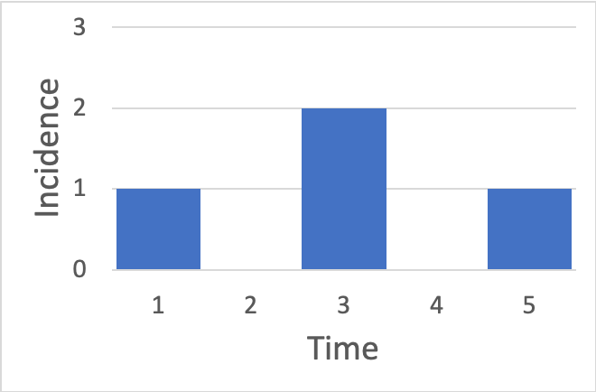
Estimating Ri(t) - Illustration
Relative infectivity over time after infection
What is R_{i}(5) ?
1 new case
Case 1 has infectivity 10% (4 days after infection)
Cases 2 and 3 have infectivity 50% (2 days after infection)
R_{i}(5) = 1/(0.1+0.5+0.5) = 0.91

Slide 17
Common issues when estimating and interpreting Ri estimates

Slide 18
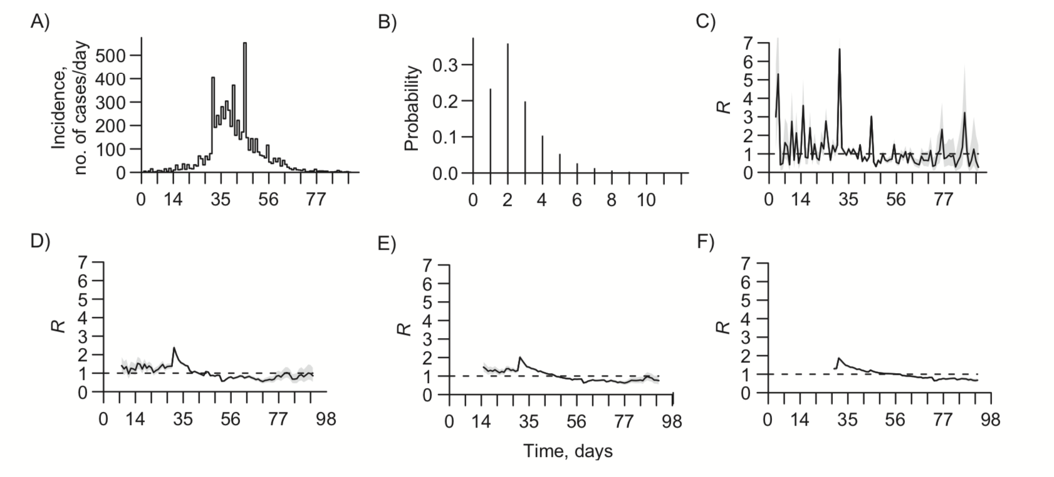
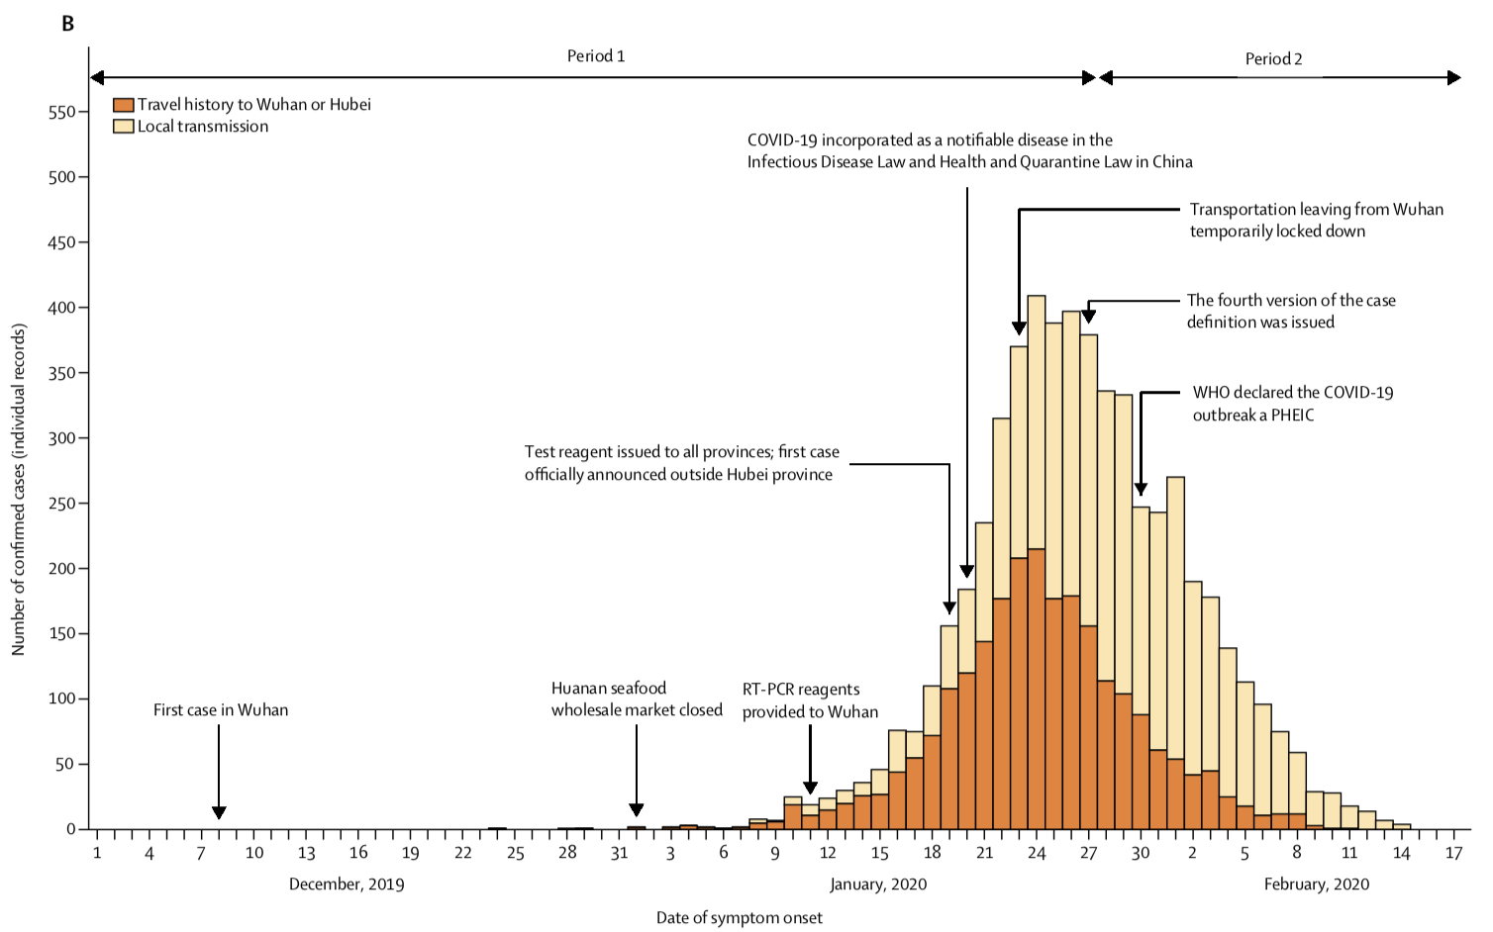
Temporal and spatial resolution
of observations and estimates
Current methods not well suited to large time steps of observations
e.g. if incidence is recorded at a time step > mean GT
Time window for estimation?
Spatial scale for analysis?
Cori et al. AJE 2013
Gostic et al. MedRxiv 2020
Thompson et al. Epidemics 2019
Zhang et al. Lancet ID 2020

Slide 19
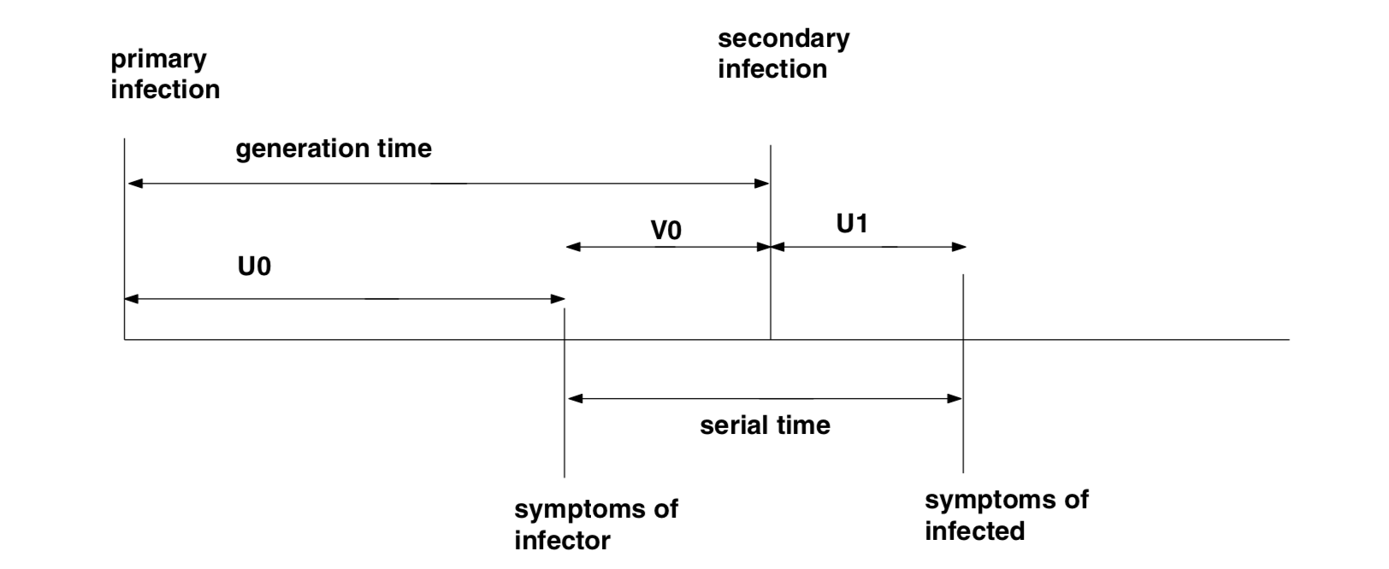
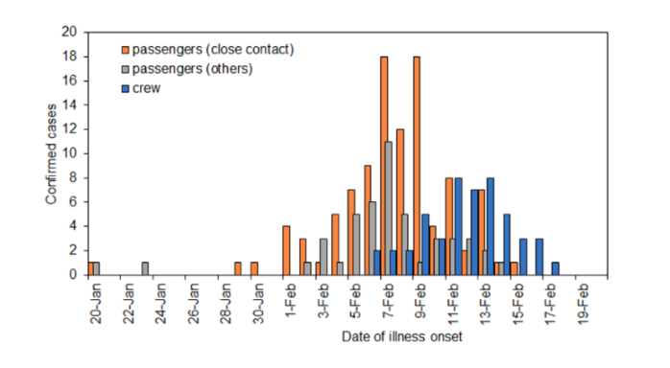
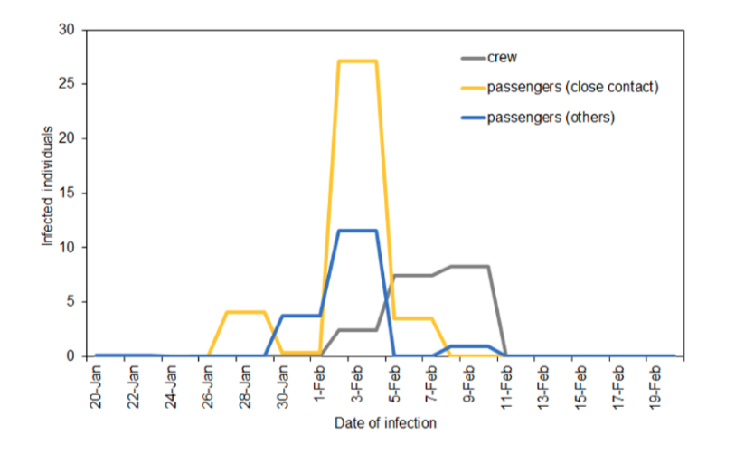
Unknown times of infection
Typically unobserved
Can be used instead but
R_{i}(t) reflects transmissibility at t - incub
Incubation
Incidence of symptoms
Incidence of infection
Svensson Math Biosc 2007
Becker et al. Stat. in Med. 1991
Goldstein et al. PNAS 2009
Gostic et al. MedRxiv 2020
Nishiura, J Clin Med 2020
Notes:
Diamond princess cruise ship

Slide 20
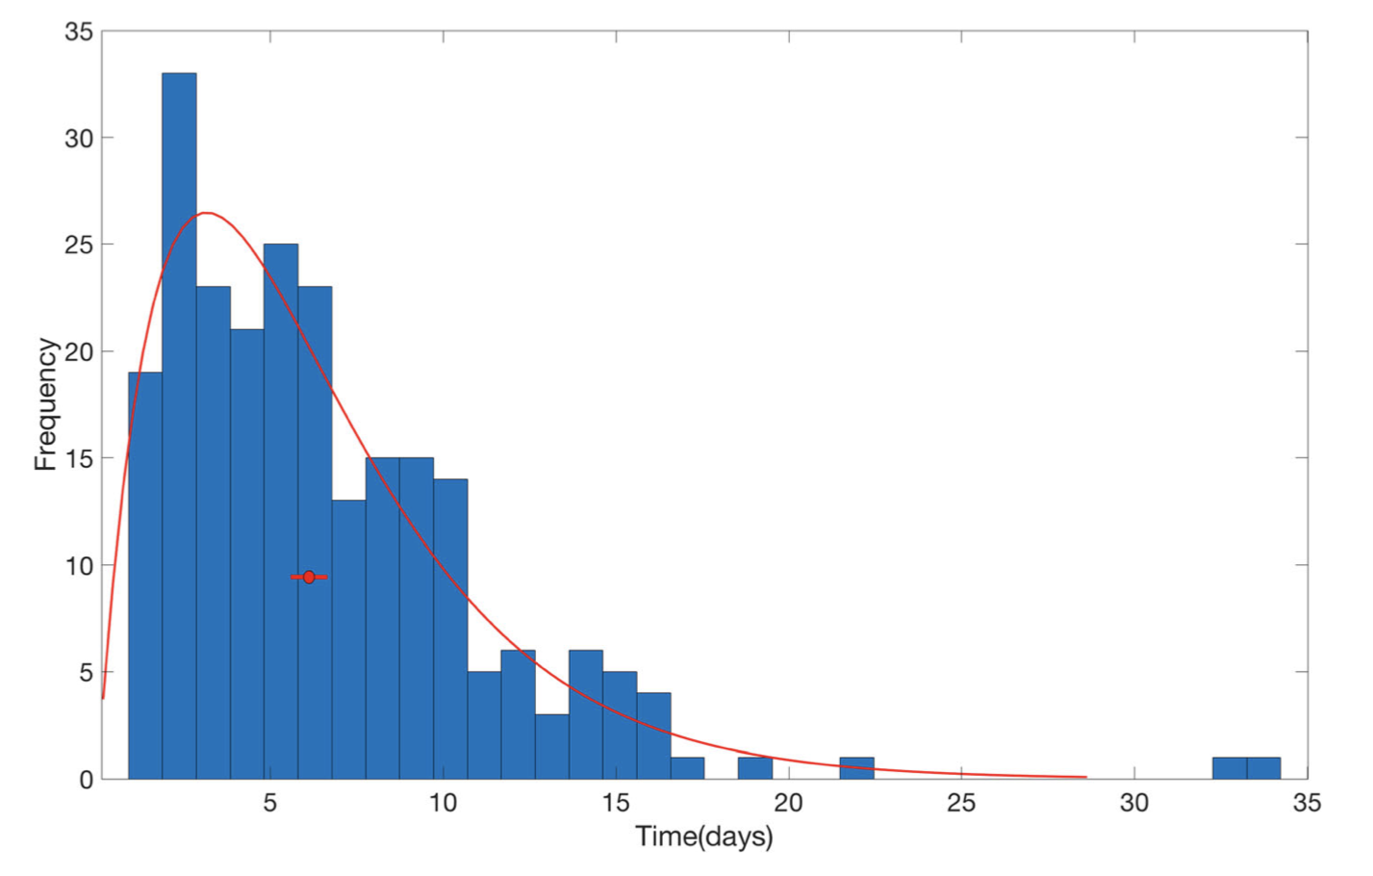
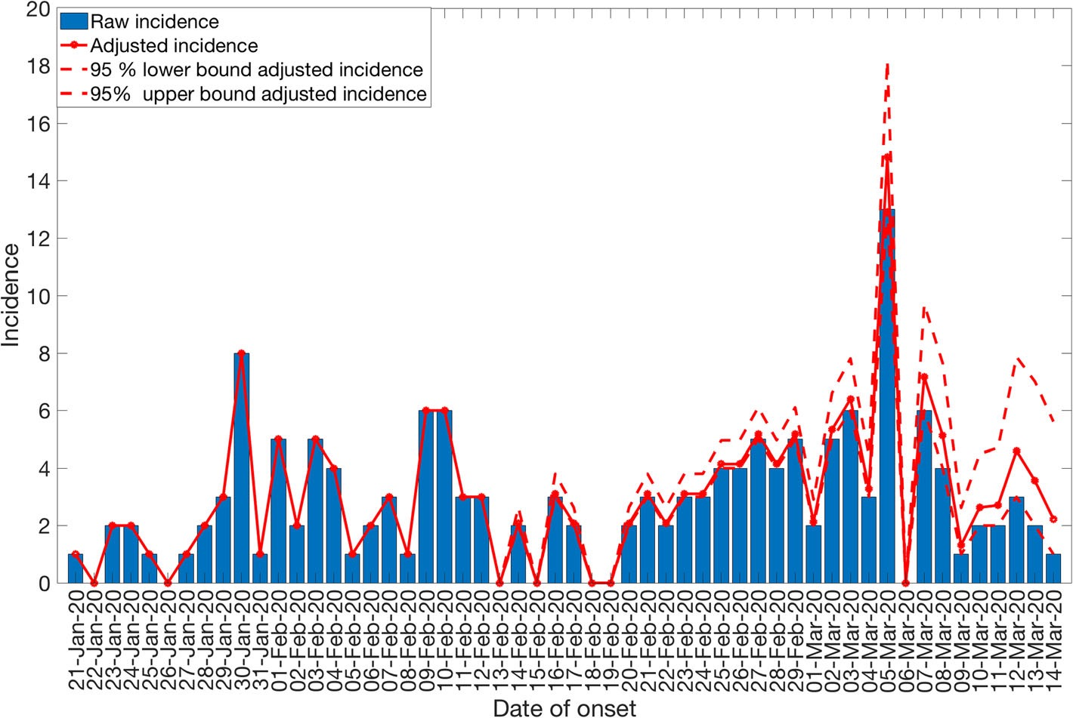
Delays in reporting
→ Underestimating R in real time
Incidence
R = ???
True incidence
R = 2
Observed so far
GT
Azmon et al. Stat Med 2014
Abbott et al. Wellcome Open Research 2020
Tariq et al. BMC Med 2020

Slide 21
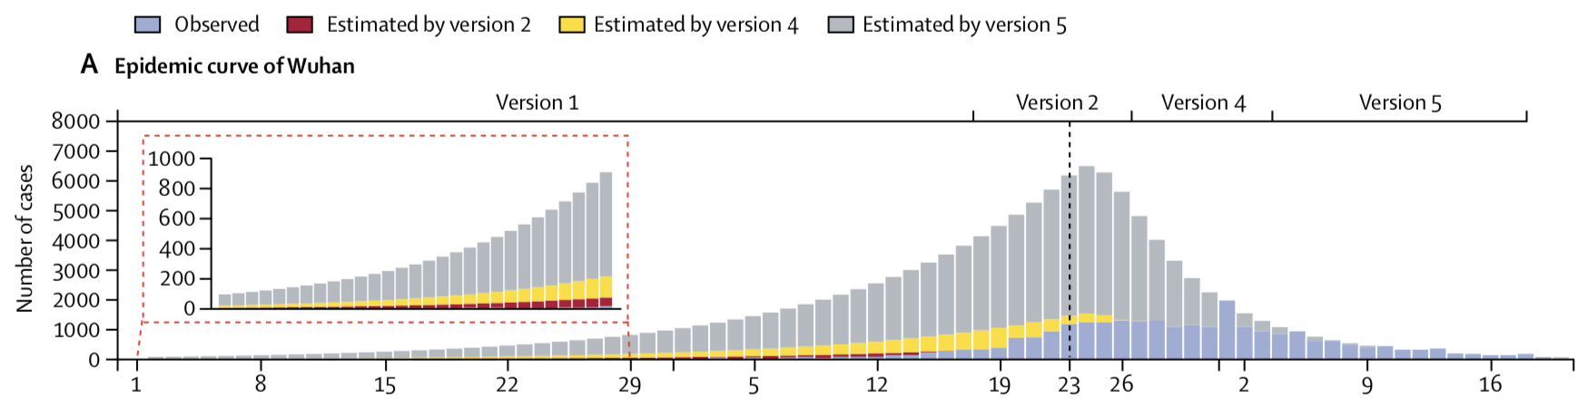
Changes in reporting over time
Tsang et al. Lancet Public Health 2020
Pitzer et al. MedRxiv 2020
https://mrc-ide.github.io/covid19-short-term-forecasts/index.html

Slide 22
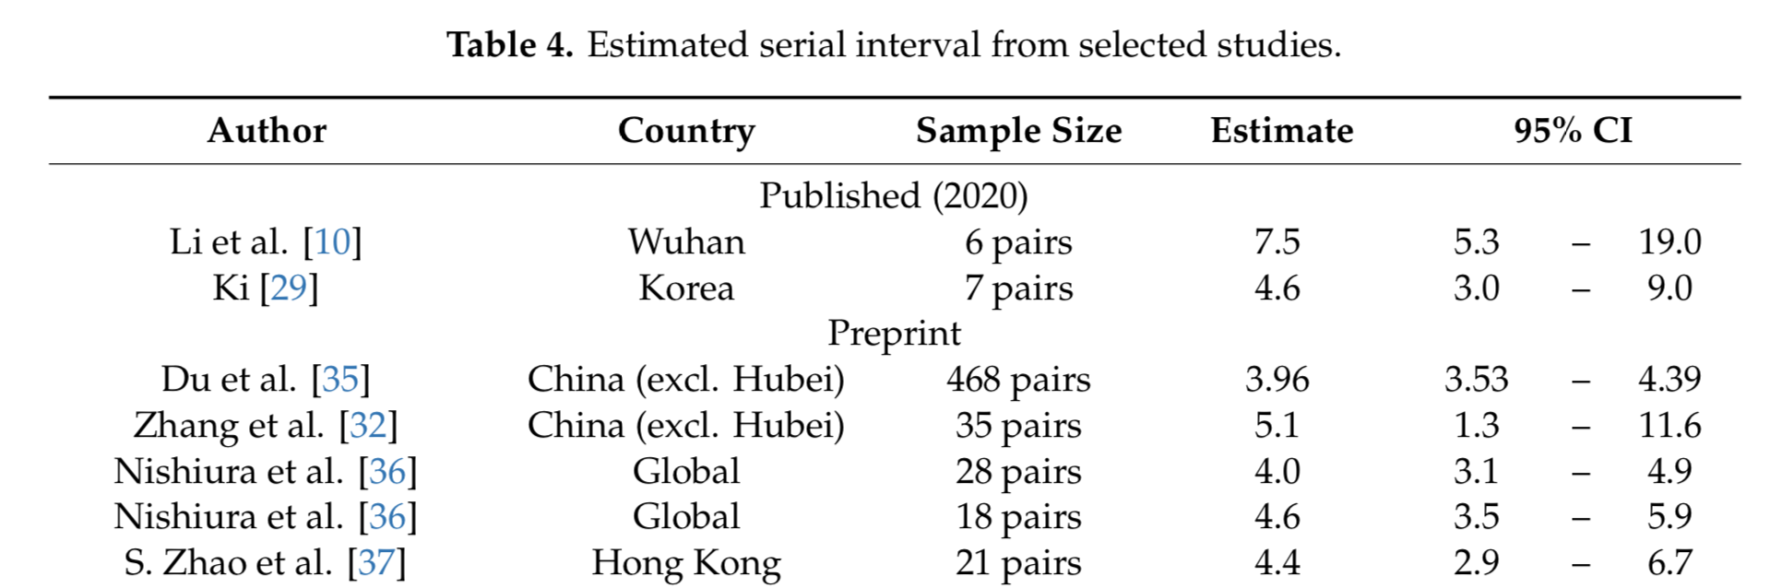
Uncertainty in the
serial interval distribution
Incidence
I_{t}
R = 5
R = 2
Short SI
Long SI
Cori et al. AJE 2013
Thompson et al. Epidemics 2019
Park et al. J Clin Med 2020

Slide 23

Changing serial interval
Ali et al. Science 2020
Notes:
Bottom: red is same (uses time variable serial interval), grey is different, from long to short SI from left to right

Slide 24
Why did R change?
Aside from all bias… R can change because of
change in the proportion of susceptibles
changes in behaviours
interventions
changes in environmental conditions
mutations?
…
combination of the above
Quantifying the contribution of different factors to changes in R is hard and requires
data (serological, behavioural, on interventions, non aggregated epi data, ...)
some modelling
Cori et al. Phil Trans Roy Soc B 2017
Flaxman et al. Nature 2020

Slide 25
Summary
Epidemic curves are a point of entry to understanding an epidemic but carry many artifacts
“The reproduction number” has multiple definitions.
The instantaneous reproduction number is the most useful for real-time monitoring of an epidemic.
There are tools to estimate it
But many uncertainties and practical issues + cautious interpretation needed.
R an important parameter but doesn’t tell you everything
Gostic et al. MedRxiv 2020

